Slide 1
Angular Day2
Presented By :Asmaa Ahmed

Slide 2


What Is a Component?
Class
Component
=
Template
+
Properties
+
Metadata
Methods
View layout
Created with HTML
Includes binding and directives
Code supporting the view
Created with TypeScript
Properties: data
Methods: logic
Extra data for Angular
Defined with a decorator

Slide 3
Component
Import
app.component.ts
import { Component } from '@angular/core';
@Component({
selector: 'pm-root',
template: `
<div><h1>{{pageTitle}}</h1>
<div>My First Component</div>
</div>
`
Metadata & Template
})
Class
export class AppComponent {
pageTitle: string = 'Acme Product Management';
}

Slide 4
Creating the Component Class
app.component.ts
export class AppComponent {
pageTitle: string = 'Acme Product Management';
}
class
keyword
Class Name
export
keyword
Component Name when used in code

Slide 5
Creating the Component Class
app.component.ts
export class AppComponent {
pageTitle: string = 'Acme Product Management';
}
Data Type
Default Value
Property Name
Methods

Slide 6
Defining the Metadata
@Component({
selector: 'pm-root', template: `
<div><h1>{{pageTitle}}</h1>
<div>My First Component</div>
</div>
`
})
export class AppComponent {
pageTitle: string = 'Acme Product Management';
}
app.component.ts

Slide 7
Decorator
A function that adds metadata to a class, its members, or its method arguments.
Prefixed with an @.
Angular provides built-in decorators.
@Component()

Slide 8
Defining the Metadata
app.component.ts
Component decorator
@Component({
selector: 'pm-root',
template: `
Directive Name used in HTML
<div><h1>{{pageTitle}}</h1>
<div>My First Component</div>
</div>
`
View Layout
})
export class AppComponent {
pageTitle: string = 'Acme Product Management';
}
Binding

Slide 9
Importing What We Need
app.component.ts
import keyword
import { Component } from '@angular/core';
@Component({
selector: 'pm-root', template: `
<div><h1>{{pageTitle}}</h1>
<div>My First Component</div>
</div>
`
})
export class AppComponent {
pageTitle: string = 'Acme Product Management';
}
Angular library name
Member name

Slide 10
Completed Component
app.component.ts
import { Component } from '@angular/core';
@Component({
selector: 'pm-root', template: `
<div><h1>{{pageTitle}}</h1>
<div>My First Component</div>
</div>
`
})
export class AppComponent {
pageTitle: string = 'Acme Product Management';
}

Slide 11



Web Server
Web Browser
URL Request (www.mysite.com)
Response
index.html
JavaScript

Slide 12
Single Page Application (SPA)
index.html contains the main page for the application
This is often the only Web page of the application
Hence an Angular application is often called a Single Page Application (SPA)

Slide 13
Hosting the Application
index.html
app.component.ts
<body>
<pm-root></pm-root>
</body>
import { Component } from '@angular/core';
@Component({
selector: 'pm-root',
template: `
<div><h1>{{pageTitle}}</h1>
<div>My First Component</div>
</div>
`
})
export class AppComponent {
pageTitle: string = 'Acme Product Management';
}

Slide 14
Defining the Angular Module
app.module.ts
import { NgModule } from '@angular/core';
import { BrowserModule } from '@angular/platform-browser'; import { AppComponent } from './app.component';
@NgModule({
imports: [ BrowserModule ],
declarations: [ AppComponent ], bootstrap: [ AppComponent ]
})
export class AppModule { }

Slide 15
Angular compiles our HTML templates and TypeScript components to JavaScript

Slide 16

Component Checklist: Class
Clear name
Use PascalCasing
Append "Component" to the name
export keyword
export class AppComponent {
pageTitle: string = 'Acme Product Management’;
}

Slide 17
Component Checklist: Members
Data in properties
Appropriate data type
Appropriate default value
camelCase with first letter lowercase
Logic in methods
camelCase with first letter lowercase
export class AppComponent {
showImage: boolean =
false;
toggleImage(): void { this.showImage = true;
}
// property
// method
}

Slide 18
Component Checklist: Import Statement
Defines where to find the members that this component needs
import keyword Member name
Correct spelling/casing
Path
Enclose in quotes
Correct spelling/casing
import { Component } from '@angular/core';

Slide 19

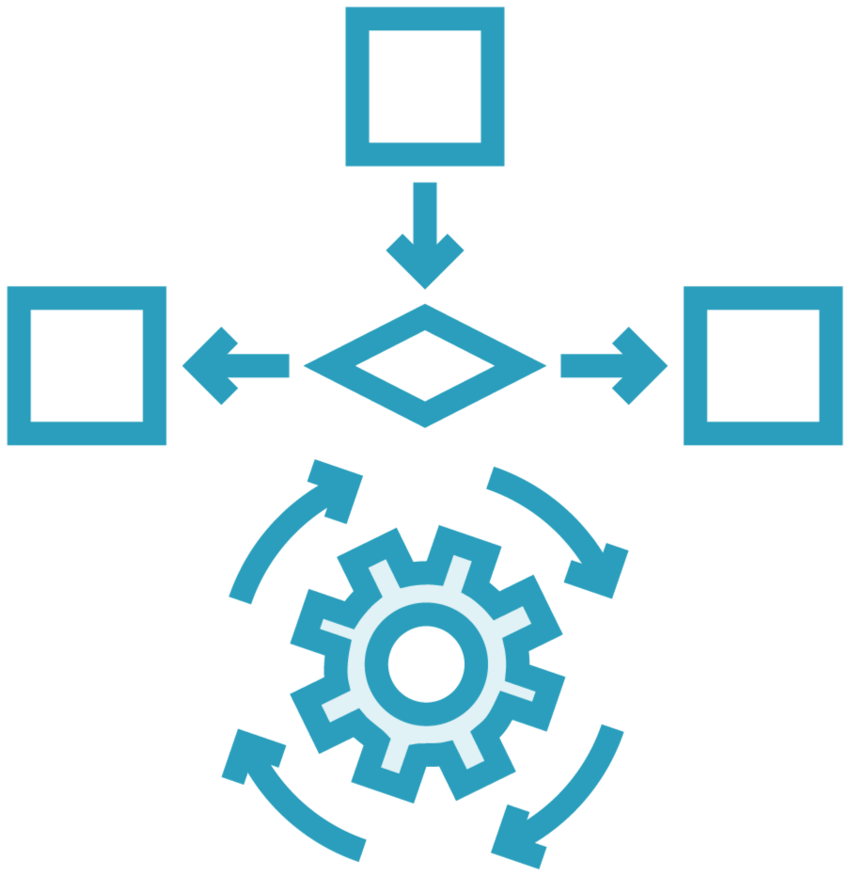

Power up HTML
Data binding
Angular directives
(Custom HTML syntax)
Angular components (Custom Directives)

Slide 20


Binding
Coordinates communication between the component's class and its template and often involves passing data.
Class
Template
Properties
Methods

Slide 21
Data Binding
DOM
Component
Interpolation: {{pageTitle}}
Property Binding: <img [src]='product.imageUrl'>
Event Binding: <button (click)='toggleImage()'>
Two-Way Binding: <input [(ngModel)]='listFilter'/>

Slide 22
Interpolation
Template
Class
<h1>{{pageTitle}}</h1>
{{'Title: ' + pageTitle}}
{{2*20+1}}
export class AppComponent { pageTitle: string =
'Acme Product Management';
}
<h1 innerText={{pageTitle}}></h1>

Slide 23
Property Binding
Element Property
Template Expression
<img [src]='product.imageUrl'>
<img src={{product.imageUrl}}>
<input type='text' [disabled]='isDisabled'/>
<img src='http://myImages.org/{{product.imageUrl}}'>

Slide 24
Property Binding
Template
Component
<h1>{{pageTitle}}</h1>
<img [src]='product.imageUrl'>
export class ListComponent { pageTitle: string = 'Product List'; products: any[] = [
{
productId: 2,
productName: "Garden Cart", productCode: "GDN-0023", releaseDate: "March 18, 2021", description: "Rolling garden cart", price: 32.99,
starRating: 4.2,
imageUrl: "assets/images/cart.png"
}, ...
];
}

Slide 25
Event Binding
Template
Component
<h1>{{pageTitle}}</h1>
<img [src]='product.imageUrl'>
<button (click)='toggleImage()'>
export class ListComponent { pageTitle: string = 'Product List'; products: any[] = […];
}
toggleImage(): void {…}
Event
Method

Slide 26
Two-way Binding
Template
Component
<div class='col-md-2'>Filter by:</div>
<div class='col-md-4'>
<input type='text’
[(ngModel)]='listFilter'/>
</div>
export class ListComponent { listFilter: string = 'cart';
}
[()]
Banana in a Box

Slide 27
Directive
Custom HTML element or attribute used to power up and extend our HTML.
Custom
Built-In

Slide 28
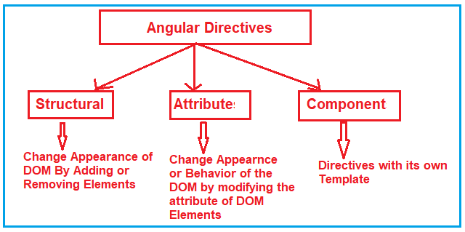
Directive
Custom HTML element or attribute used to power up and extend our HTML.
Built-In

Slide 29



Transforming Data with Pipes
Transform bound properties before display
Built-in pipes: date, number, decimal, percent, currency, json, etc.
Custom pipes

